Slide 1


How to inspire users to unstick from Email
#SPSBE
Luise Freese| @LuiseFreese
SharePoint Saturday Belgium 2019

Slide 3


About Luise Freese
Office 365 Consultant
Strategy
Communication
User Adoption
Microsoft MVP Office Apps & Services
#workingmom, today supported by #ClaraUnicorn 🦄
Feel free to connect with me and tweet about this session on twitter @LuiseFreese

Slide 4
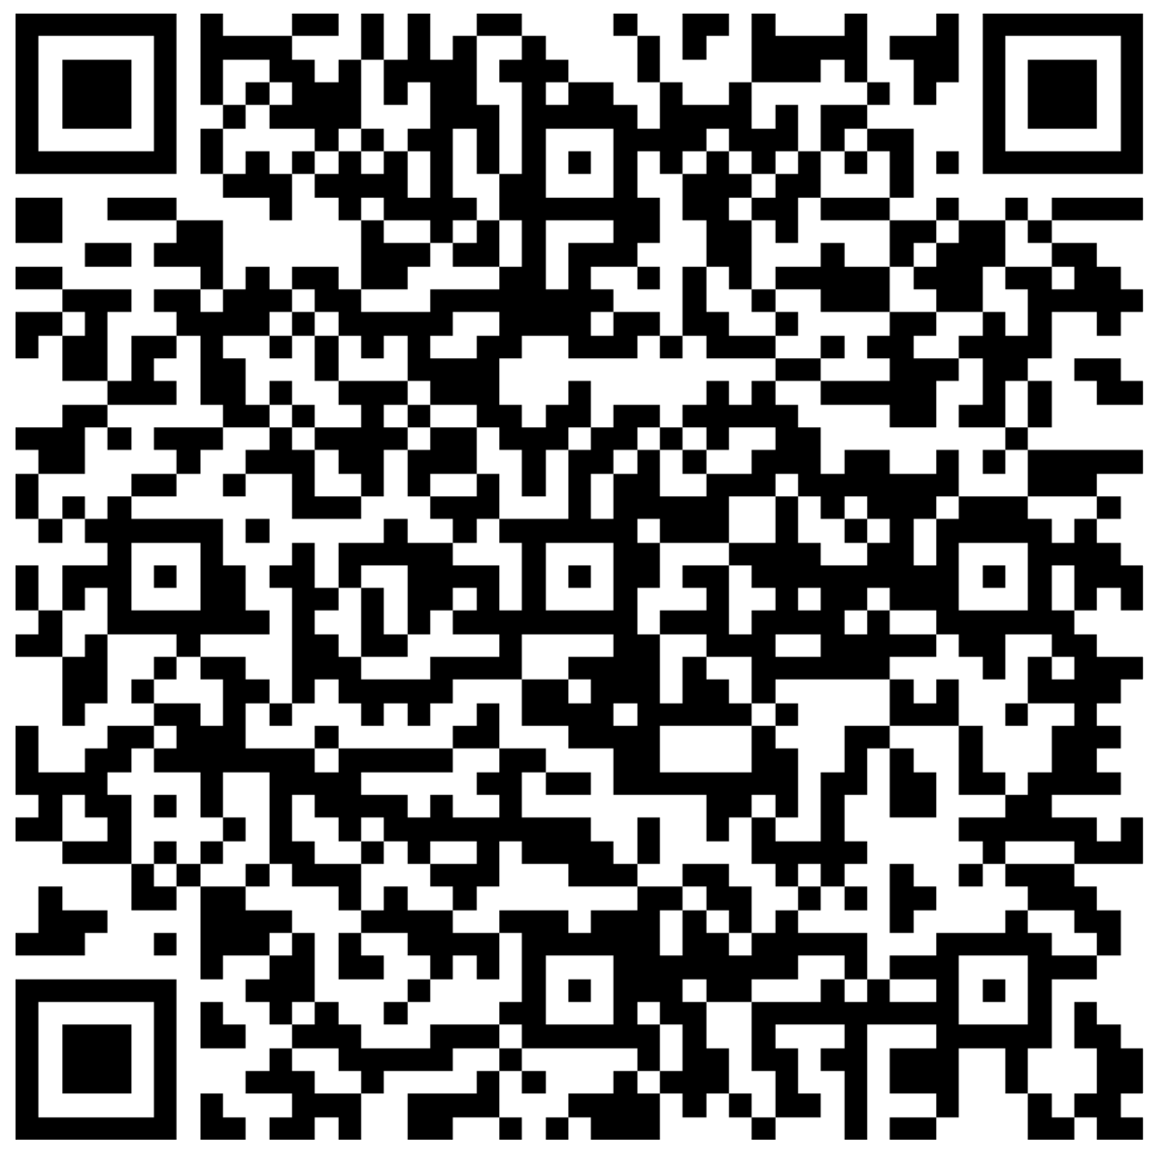

















You want the slides? You‘ll get the slides!
http://bit.ly/SPSBE

Slide 5

What is email?
If you only have a hammer, everything seems to be a nail.
"Dieses Foto" von Unekannter Autor ist lizenziert gemäß CC BY-NC

Slide 6
Email is (ab)-used as a tool for
Taskmanagement
Document Management
Discussion within a team
Private chat

Slide 7
Which causes some serious issues
Intransparency regarding tasks
Versionitis and cumbersome file names
Cascading folder structures
consecutively working behavior
Email flood which nobody is able to deal with
Loss of focus

Slide 8

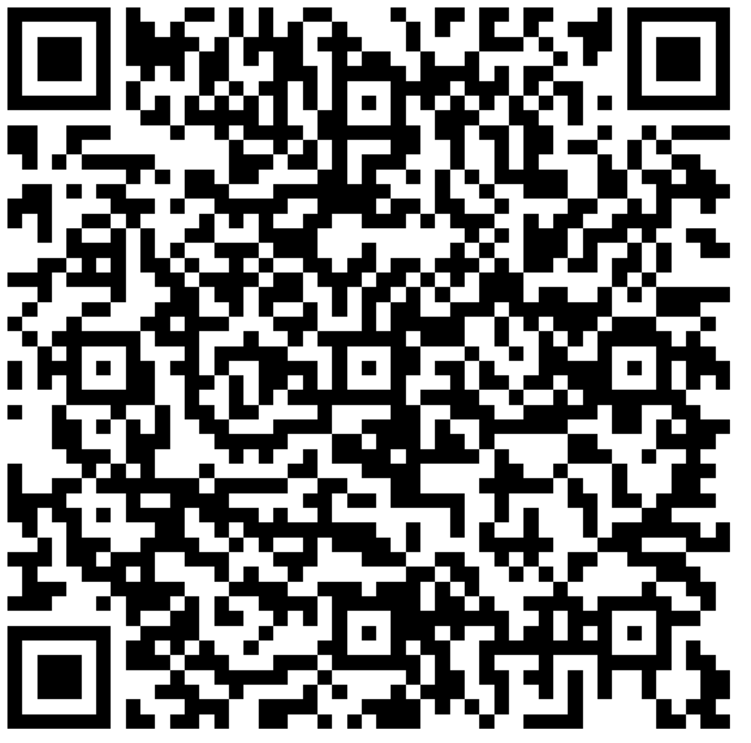
Where do we save that file?
Story:
I want to save a non-final version of a .pptx file, which is related to my Project Deathstar.
Project Deathstar
Presentations
Drafts

Slide 9

Metadata
modified
file name
modified by
Status
Project name
Version
Some random bullsh*t
vs.

Slide 10

What if our employees not only had a hammer?
"Dieses Foto" von Unbekannter Autor ist lizenziert gemäß CC BY-SA

Slide 11
Outlook – my wishlist
Get an overview about my tasks – week per week
Group my tasks by project
Find my stuff in no time
Achieve inbox zero

Slide 12
How to deal with email
demo

Slide 13
Planner & To-Do
demo

Slide 14
Tip No. 1: Task management
Microsoft To-Do for personal productivity
Microsoft Planner for group tasks: transparency and uncluttered view on everything
Connect To-Do with flagged Email and tasks assigned to me

Slide 15
What do you get by creating a Planner plan?
An Outlook email inbox to record conversations between Group members
A shared Outlook calendar to post events and appointments that affect Group members
A SharePoint site collection (which you access through the “Files” tab)
A OneNote notebook (which actually lives in your SharePoint site collection)
A Plan in Planner
A Stream video portal
A Power BI workspace (if you have premium Power BI licenses for all members).
Source: Matt Wade, http://icansharepoint.com/everyday-guide-office-365-groups/

Slide 16
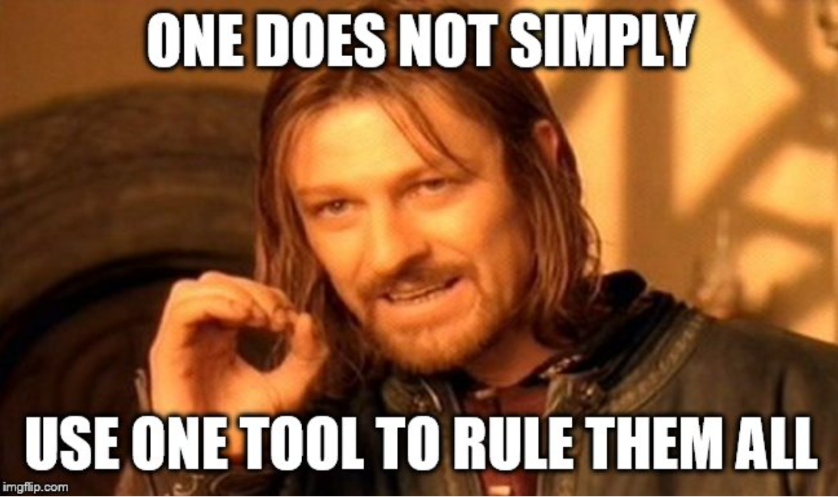

Slide 17
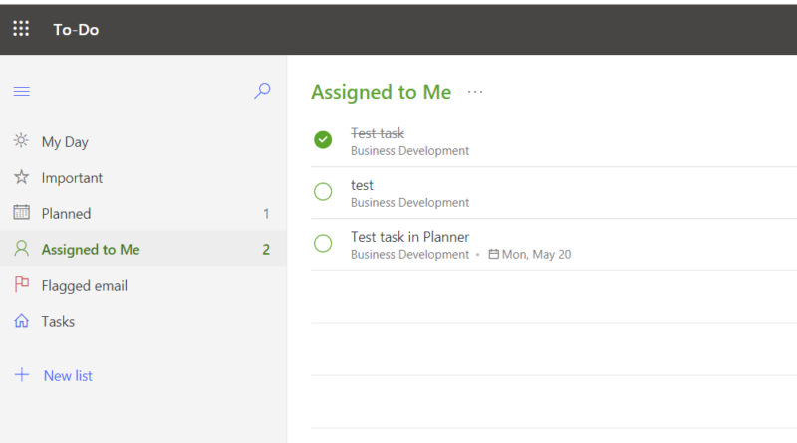

Slide 18
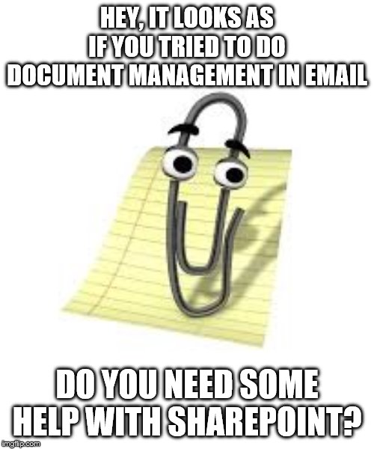
Tip No 2: Document management
Inspire them to Stop sending, start sharing
Explain how libraries work
Introduce them to approval flows

Slide 19
Tip No. 3: Discussion: Microsoft Teams as secure workplace
threaded group-chat in theme-based channels
an associated SharePoint site (and that library 💡 )
Video conferencing including desktop sharing
Private chat

Slide 20
Our (basic) Modern Workplace Toolbox
Document Management
SHAREPOINT
Personal Productivity
TO-DO
Task Management
PLANNER
Communication with Customers
OUTLOOK
Discussion & Collaboration
TEAMS

Slide 21

Summary
A hammer is a great tool, but we need an entire toolbox to be productive
People don‘t necessarily want new tools, they want to get their work done
Change takes time

Slide 22

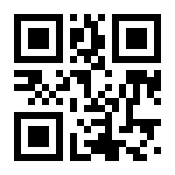
http://spsbe.be
#SPSBE
Please rate this session!

Slide 23

#SPSBE
SharePoint Saturday Belgium 2019

